Slide 1
Fuselage CAD

Slide 2
Paper Planes!
Which flew longer?
Best glide ratio?
(glide ratio - how far you go forward vs down)
Which flew farther?
Plane 1:
Plane 2:
Notes:
Alex Note to presenters: be ready to explain their observations →
Farthest
Slowest
Best glide ratio

Slide 3
Agenda
10 min — setting up beam feature
5 min — creating path
5 min — create beam and share
5 min — introduce affordaplane challenge
25 min — affordaplane sketch
10 min — affordaplane pipe
Notes:
Jasmine

Slide 4
Beam Feature
So you can build beams with less pain!
Notes:
All Alex — split into breakout rooms, alex takes people who don’t understand, jasmine takes people who do and goes straight to the challenge

Slide 5
Create a new doc

Slide 6
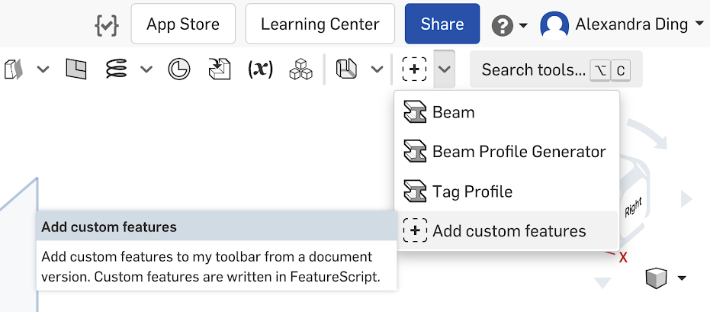
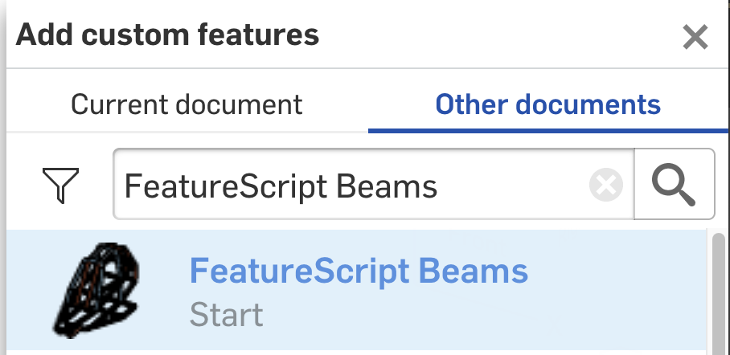
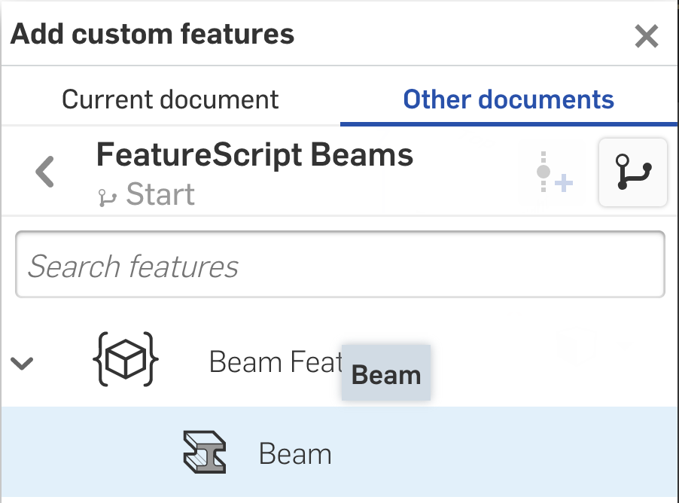
Installing
Go to the right side of your toolbar and click the plus → Add custom features
Search for “FeatureScript Beams” and click the first result
Select Beam Features → Beam

Slide 7
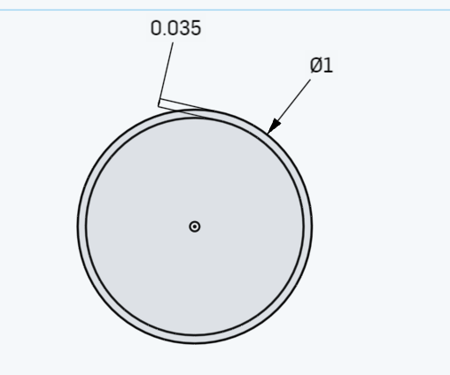
Creating Profiles
Open a sketch and create the tube profile you want the beams to take on
You do this by making 2 concentric circles
Outer Diameter: 1 in
Thickness: 0.035 in
These dimensions are the same as our fuselage pipes!

Slide 8
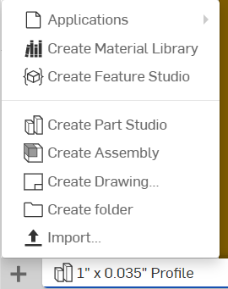
Set up Beams
2. Start a new Part Studio
Name this one “beam tinkering”

Slide 9
5 minute Activity: create any path! Any series of lines connected!
If you want a challenge:
Try using the “arc” feature

Slide 10
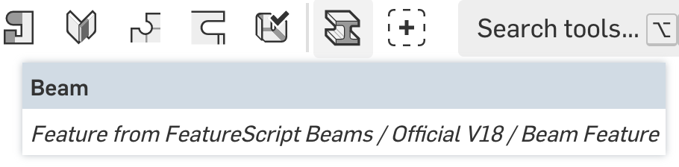
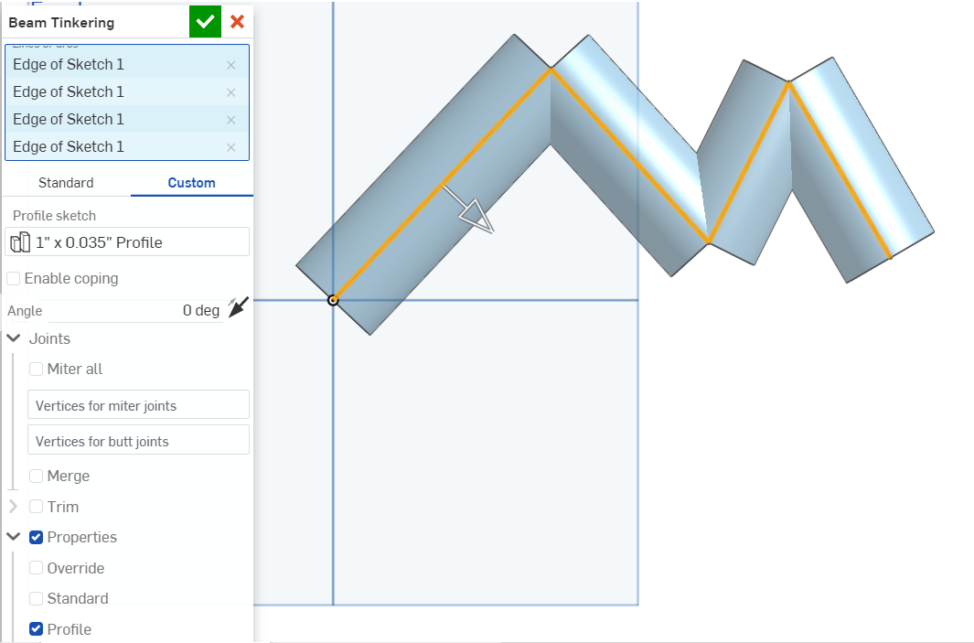
Creating Beams
3. Click the beams profile in the top
4. “Custom”
5. “Select Part Studio”
6. Select the sketch that you made the profile in originally
7. Select the lines that you just made

Slide 11
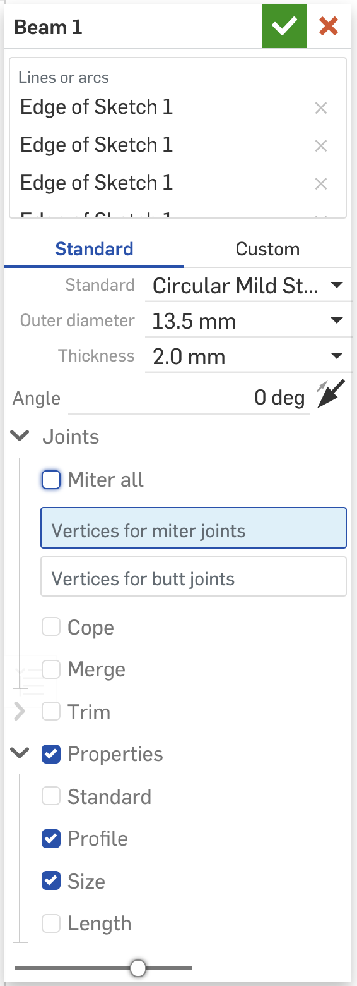
You can also hit “standard” and play around with all the properties they have built in!

Slide 12
Anyone willing to share what they created?

Slide 13
Challenge
Let’s see what you learned!

Slide 14
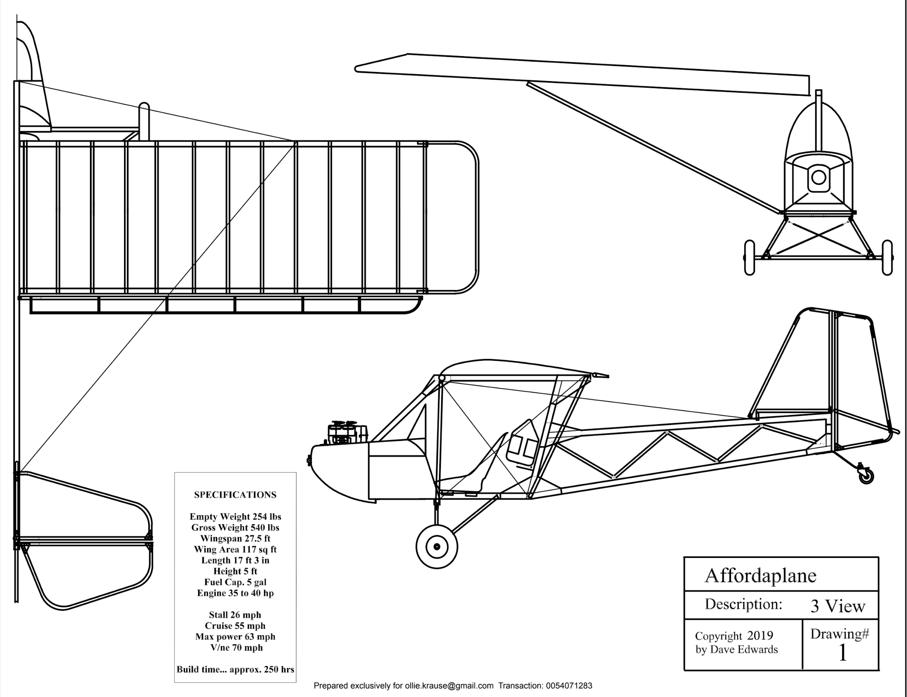
The Affordaplane!
We referenced this ultralight a lot while designing our own plane. Now you’re going to try to CAD this fuselage using everything you’ve learned.

Slide 15
You will be CADing this.

Slide 16
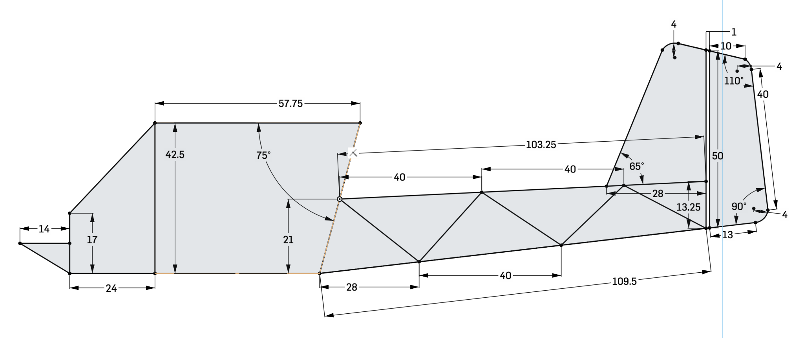
The Sketch
Try to sketch this roughly. Don’t worry about the constraints right now, and don’t sketch the tail.

Slide 17
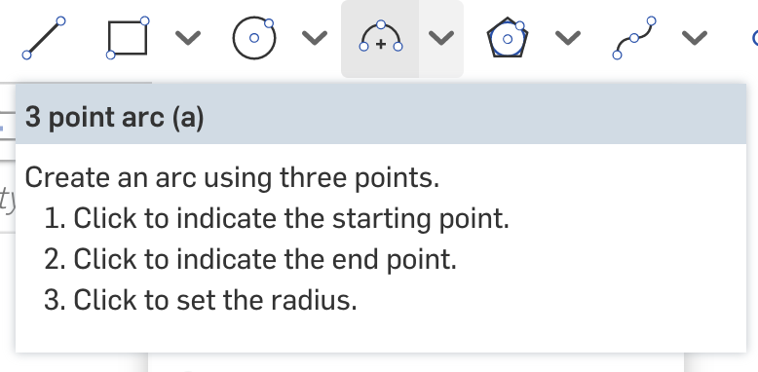
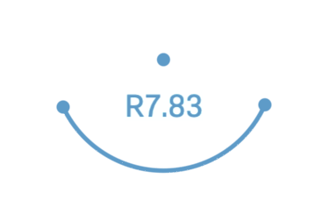
1a. Tail
The tail uses three-point arcs for the rounded corners
Click the arc tool or press a.
Click two points for the endpoints of the arc, then another point for the center of the arc (imagine that the arc is part of a circle).

Slide 18
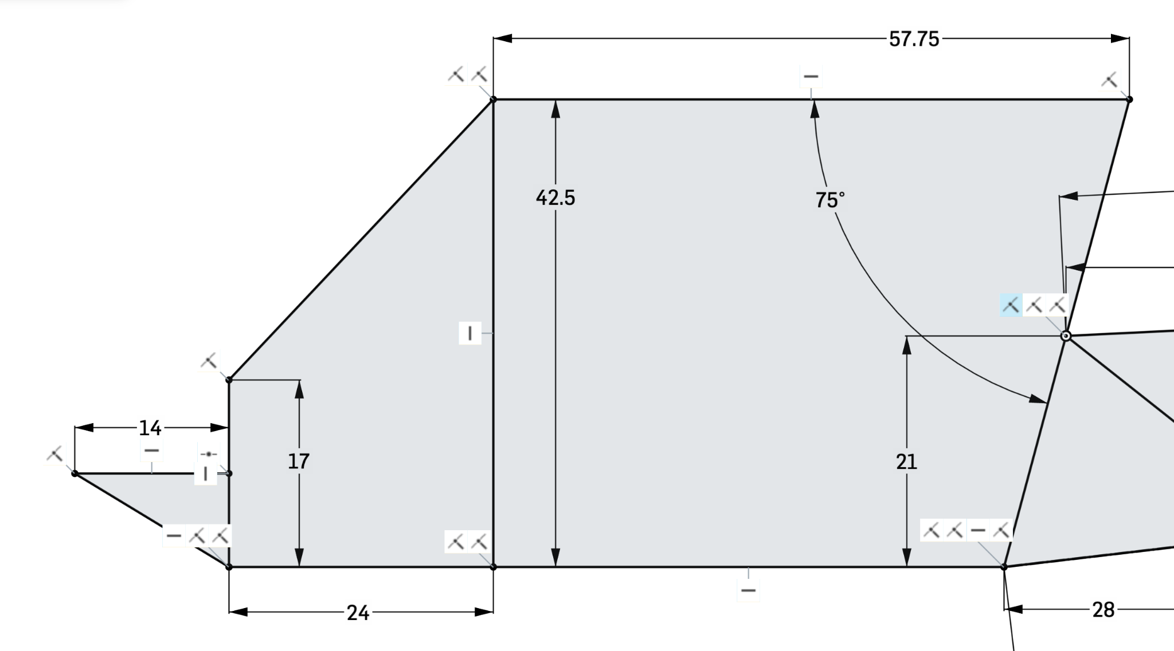
1b. Cabin Constraints
Coincident constraints
Note the coincident between this joint and the origin.(If you don’t have this everything will be blue.)
Horizontal constraint
Vertical constraint

Slide 19
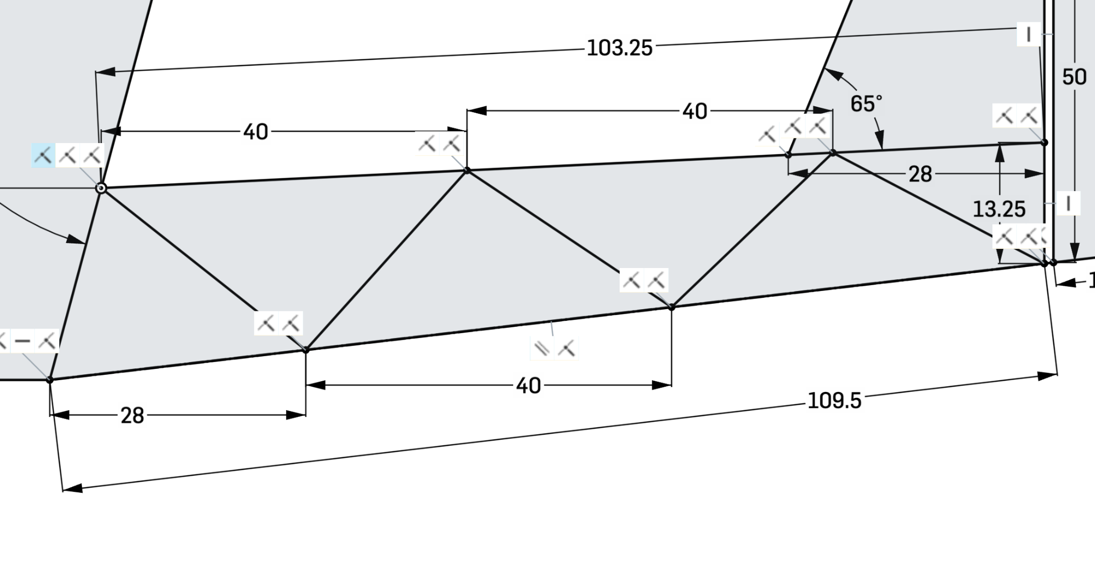
1c. Empennage Constraints
You can dimension an angle by using the dimension tool and clicking the two lines the angle will be between
Parallel constraint

Slide 20
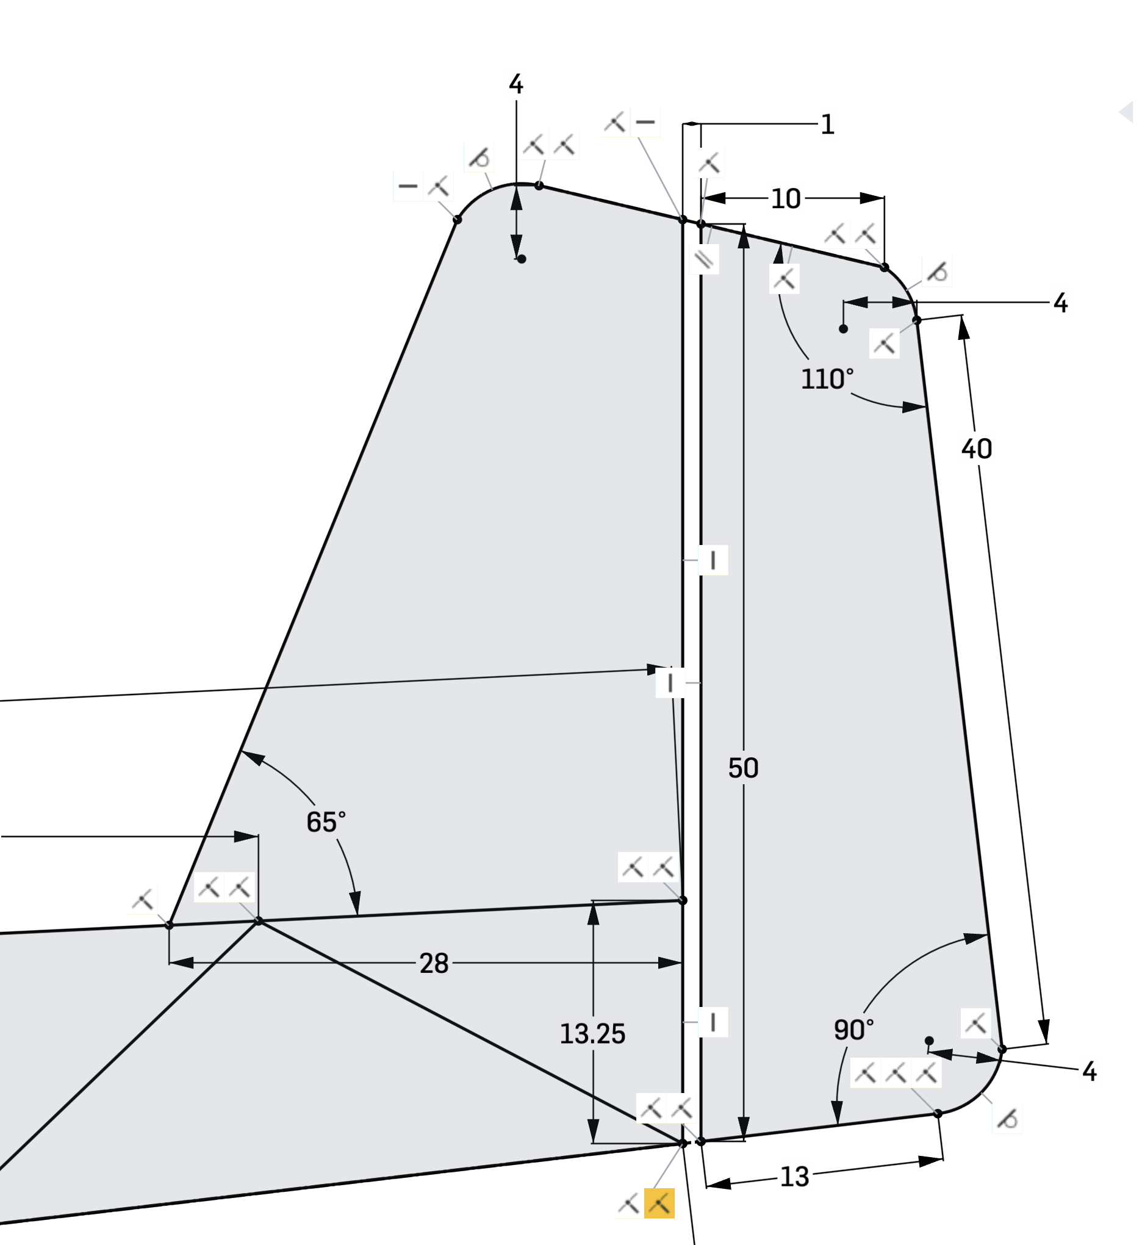
1d. Tail Constraints
Tangent constraint
You do not have to get everything
If your sketch looks somewhat like this, you’re good.

Slide 21
Congratulations! The hard part is over!

Slide 22
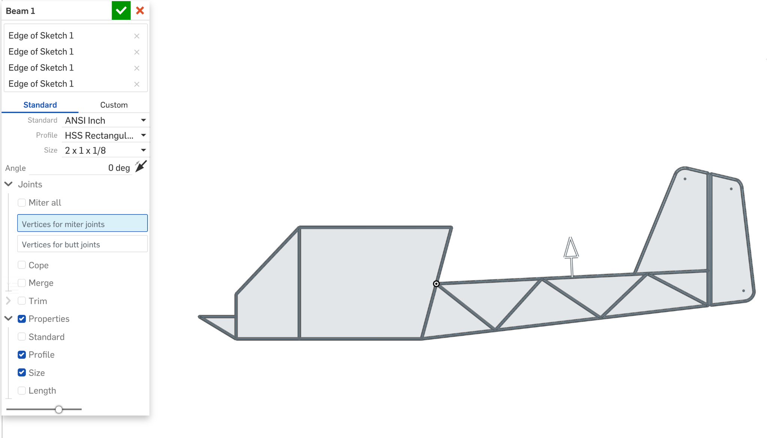
2a. Beams
Use the beam tool to create beams on your sketch

Slide 23
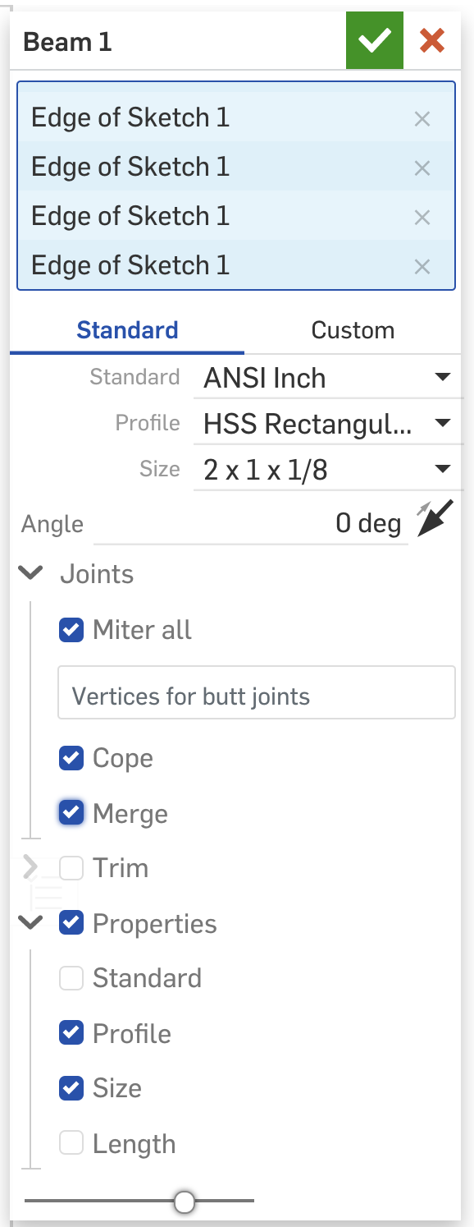
2b. Beam Settings
Play around with the settings. The affordaplane uses rectangular beams.
You can also make a custom beam, like you just learned!

Slide 24
Anyone willing to share what they’ve accomplished?

Slide 25
That’s all! Congratulations, you’ve made your own fuselage!

Slide 26
Notes From Doc
Just an introduction into Onshape → making an account, first sketch, first extrude, etc. Have them download the tubing script too
Make a 2D fully constrained sketch of a fuselage just for practice with all the things
1:1 scale → all the good dimensions
Have them peer edit each other’s designs
Work with all the good keyboard shortcuts
https://cad.onshape.com/documents?resourceType=filter&nodeId=1

Slide 27
Outline
Make an account
First sketch + constraints
Create a shape + Extrude (making a chair?)
Add a plane and sketch + loft
Using mirror constraint + revolve
Beam
Anyone willing to share their creations?
Challenge: 2d fuselage with beams (affordaplane style)

